Slide 1
Sales Dashboard

Slide 2
About Sales Dataset:
Sales dataset of a global store for 4 years.
It consists of multiple columns including Profits, Quantity,Cost,Sales , order dates and shipping dates etc.
Creating dashboard using multiple visuals ,KPI ,Page Navigation button to highlight needed for business insights.

Slide 3
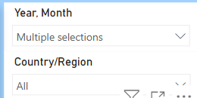
Slicer:
A slicer is an interactive filter in data visualization tools that allows users to dynamically refine and display specific data in dashboards.
Slicers used here as Dropdown for Year,Month and Country display.

Slide 4
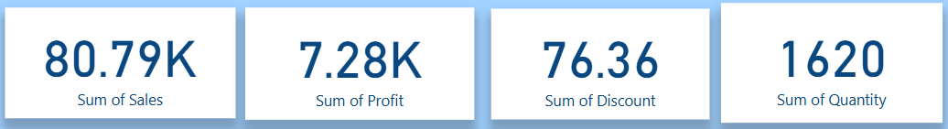
Card Visual:
a Card visual (often called a Text Card) is used to display a single number or text value.
It is useful when you want to highlight a key metric at a glance.
Card used here shows Sales,Profit,Discount and Quantity.

Slide 5
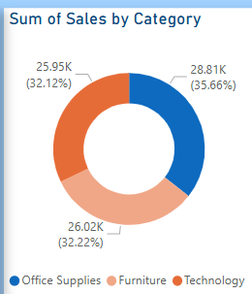
Donut Chart:
Visualizing the proportion of categories It shows how each category contributes to the total, as slices of a circle.
This chart used here to show the sales by Category.

Slide 6
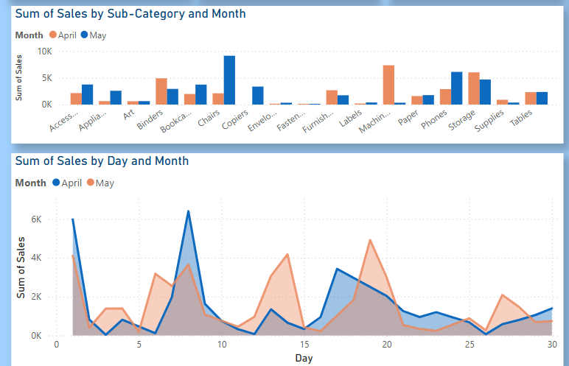
Column chart and Area Chart:
Column chart,Bar chart,Pie chart or Stacked charts used for showing categorical comparisions.
This chart used for comparing monthly sales by category .

Slide 7
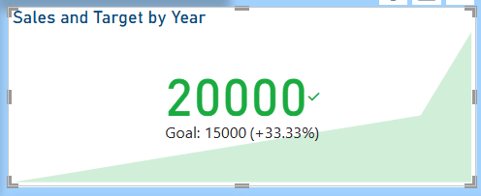
KPI Visual:
KPIs (Key Performance Indicators) are used to visually track and assess the performance of a value against a target. They help stakeholders quickly understand if performance is on track, above, or below expectations.

Slide 8

Page Navigation
Page navigation in Power BI allows you to create interactive reports where users can click buttons or shapes to move between different report pages—similar to navigating through a website or app.
This button used as page navigation to Details sheet to see detailed information about orders.

Slide 9
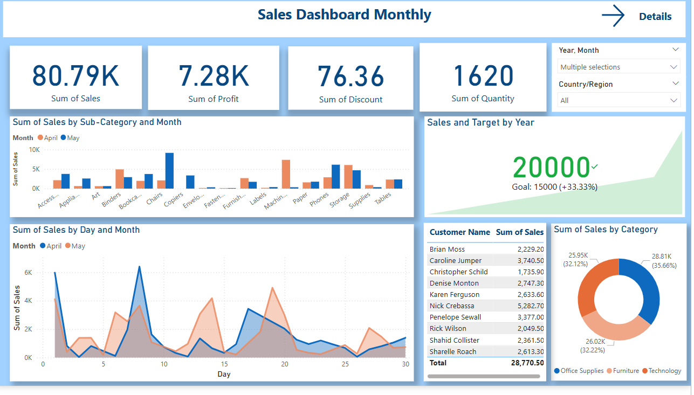

Slide 10
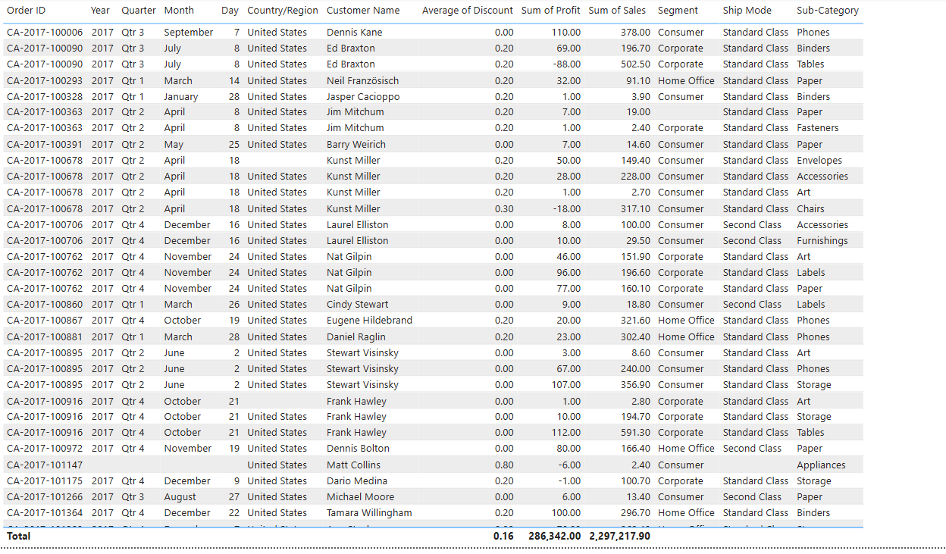

Slide 11
Thank You

